Slide 1

CS4055-Digital Image Processing
Introduction
Notes:
1

Slide 2
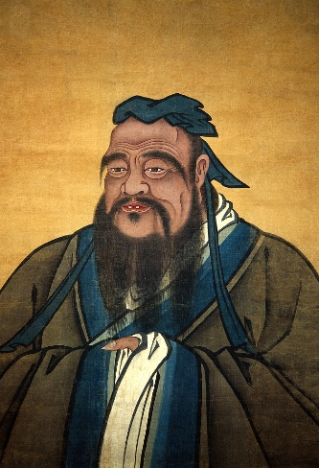
Introduction
“One picture is worth more than ten thousand words” By Confucius
Notes:
2
Five senses, 99% activity
Of the five senses – sight, hearing, touch, smell and taste – which humans use to perceive
their environment, sight is the most powerful. Receiving and analyzing images forms a
large part of the routine cerebral activity of human beings throughout their waking lives.
In fact, more than 99% of the activity of the human brain is involved in processing images
from the visual cortex. A visual image is rich in information. Confucius said, “A picture is
worth a thousand words,” and we shall see that that is an underestimate.

Slide 3
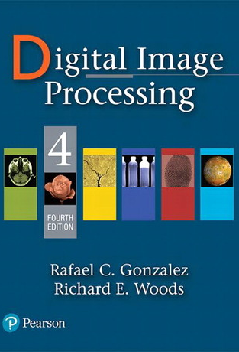
References
“Digital Image Processing”, Rafael C. Gonzalez & Richard E. Woods, Addison Wesley, Pearson Education, 4th Edition, 2021.
Muost of the material that follows is taken from this book
Notes:
3

Slide 4

Course Outline
Why image processing? The human visual system, electromagnetic system, reflection based imaging, pixels, image representation, sampling, quantization, image formation, point operations, neighborhood based operations, Fourier theory, image filtering in spatial and frequency domain, image restoration, image registration, morphological operations, image segmentation, pattern recognition.
Notes:
4

Slide 5
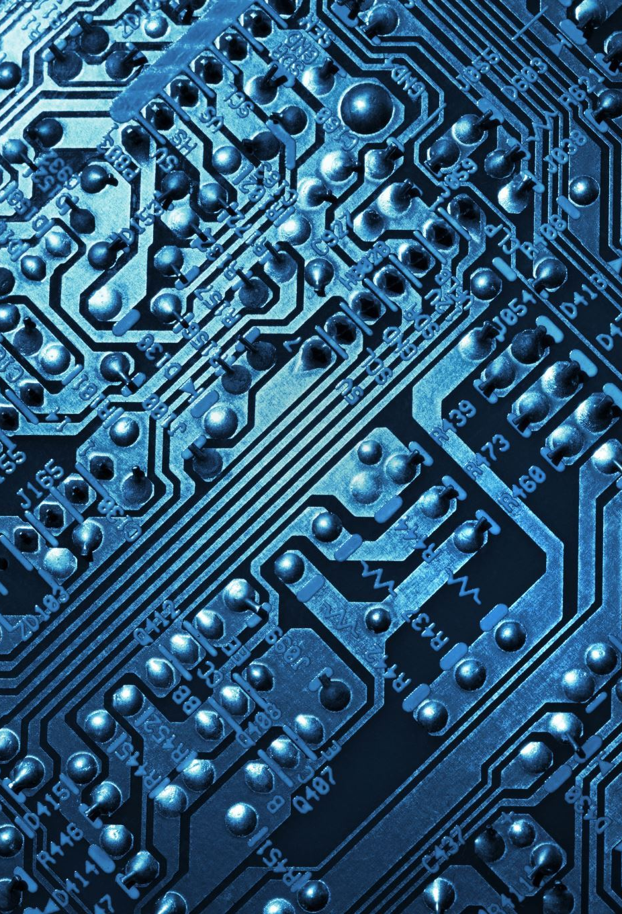
Contents
This lecture will cover:
Digital image
Digital image processing
History of digital image processing
State of the art examples of digital image processing
Key stages in digital image processing
Notes:
5

Slide 6
Image Formation: Reflected Light
White Light
The colours that we perceive are determined by the nature of the light reflected from an object
For example, if white light is shone onto a green object most wavelengths are absorbed, while green light is reflected from the object
Colours Absorbed
Green Light

Slide 7
Image Formation Model
Amplitude values:
f(x,y) = i(x,y)*r(x,y)+n(x,y)
0<f(x,y)<∞
Intensity – proportional to energy
radiated by a physical source
0<i(x,y)<∞
illumination
0<r(x,y)<1
reflectance
n(x,y)
noise

Slide 8

A digital image is a representation of a two-dimensional image as a finite set of digital values, called picture elements or pixels
Digital Image
Source: Gonzalez & Woods, Digital Image Processing
Notes:
8
Real world is continuous – an image is simply a digital approximation of this.

Slide 9

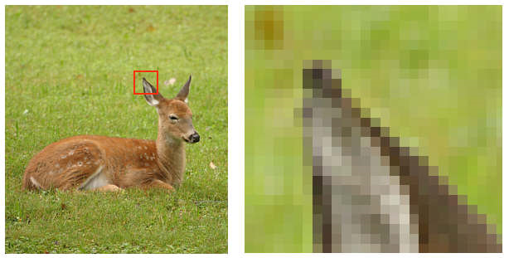
Digital Image (cont…)
Pixel values typically represent gray levels, colours, heights, opacities etc.
Remember digitization implies that a digital image is an approximation of a real scene
Image Source: Gonzalez & Woods, Digital Image Processing
1 pixel
Notes:
9

Slide 10
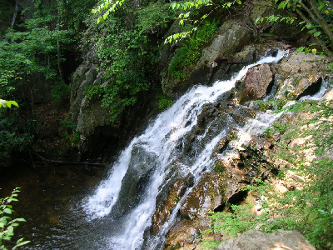
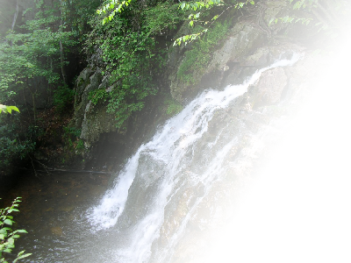
Digital Image
Common image formats include:
1 sample per point (B&W or Grayscale)
3 samples per point (Red, Green, and Blue)
4 samples per point (Red, Green, Blue, and “Alpha”, a.k.a. Opacity)
For most of this course we will focus on grey-scale images
Notes:
10

Slide 11

Digital image processing focuses on two major tasks:
Improvement of pictorial information for human interpretation
Processing of image data for storage, transmission and representation for autonomous machine perception
Some argument about where image processing ends and fields such as image analysis and computer vision start
Notes:
11

Slide 12
Digital image processing
The continuum from image processing to computer vision can be broken up into low-, mid- and high-level processes
Low Level Process
Mid Level Process
High Level Process
Input: Image Output: Image
Examples: Noise removal, image sharpening
Input: Image Output: Attributes
Examples: Object recognition, segmentation
Input: Attributes Output: Understanding
Examples: Scene understanding, autonomous navigation
In this course we will stop here
Notes:
12
Give the analogy of the character recognition system.
Low Level: Cleaning up the image of some text
Mid level: Segmenting the text from the background and recognising individual characters
High level: Understanding what the text says

Slide 13
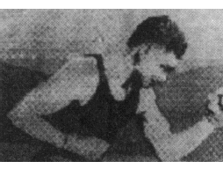
Digital Image Processing History
Early 1920s: One of the first applications of digital imaging was in the news- paper industry
The Bartlane cable picture transmission service
Images were transferred by submarine cable between London and New York
Pictures were coded for cable transfer and reconstructed at the receiving end on a telegraph printer
Notes:
13

Slide 14
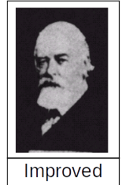
History of DIP (cont…)
Mid to late 1920s: Improvements to the Bartlane system resulted in higher quality images
New reproduction processes based on photographic techniques
Increased number of tones in reproduced images
Notes:
14

Slide 15
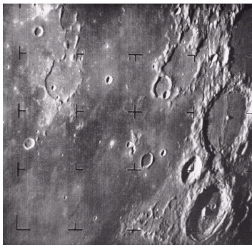
History of DIP (cont…)
1960s: Improvements in computing technology and the onset of the space race led to a surge of work in digital image processing
1964: Computers used to improve the quality of images of the moon taken by the Ranger 7 probe
Such techniques were used in other space missions including the Apollo landings
A picture of the moon taken by the Ranger 7 probe minutes before landing
Notes:
15

Slide 16
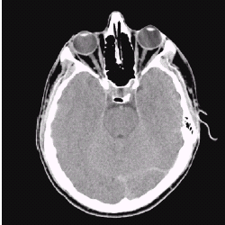
History of DIP (cont…)
1970s: Digital image processing begins to be used in medical applications
1979: Sir Godfrey N. Hounsfield & Prof. Allan M. Cormack share the Nobel Prize in medicine for the invention of tomography, the technology behind Computerised Axial Tomography (CAT) scans
Typical head slice CAT image
Notes:
16

Slide 17
History of DIP (cont…)
1980s - Today: The use of digital image processing techniques has exploded, and they are now used for all kinds of tasks in all kinds of areas
Image enhancement/restoration
Artistic effects
Medical visualisation
Industrial inspection
Law enforcement
Human computer interfaces
Notes:
17

Slide 18
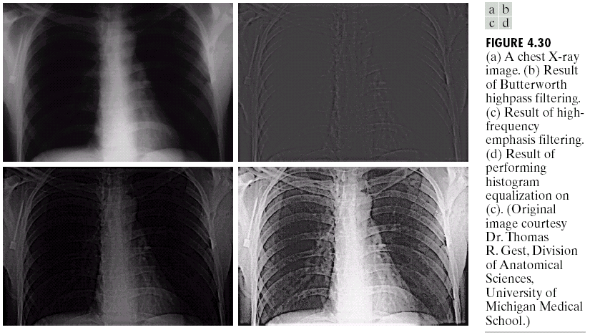
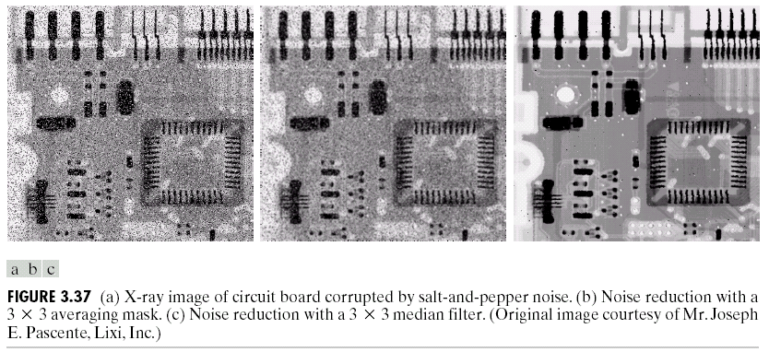
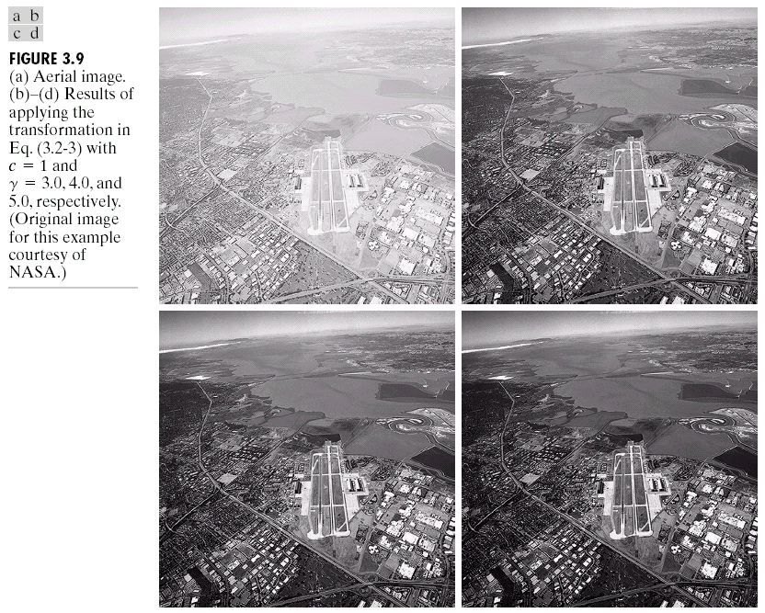
Image Enhancement
One of the most common uses of DIP techniques: improve quality, remove noise etc
Notes:
18

Slide 19
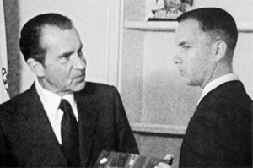
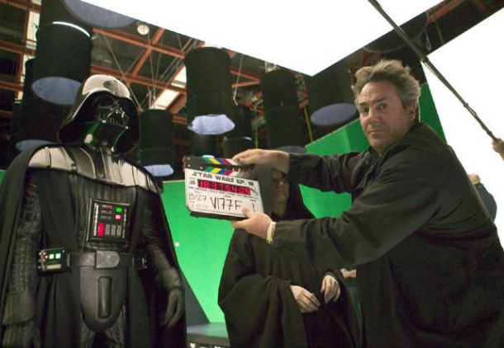
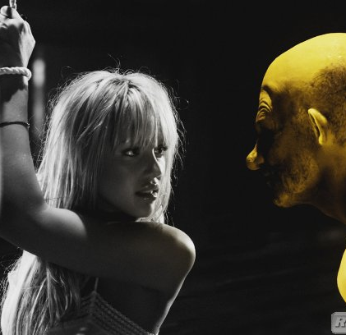
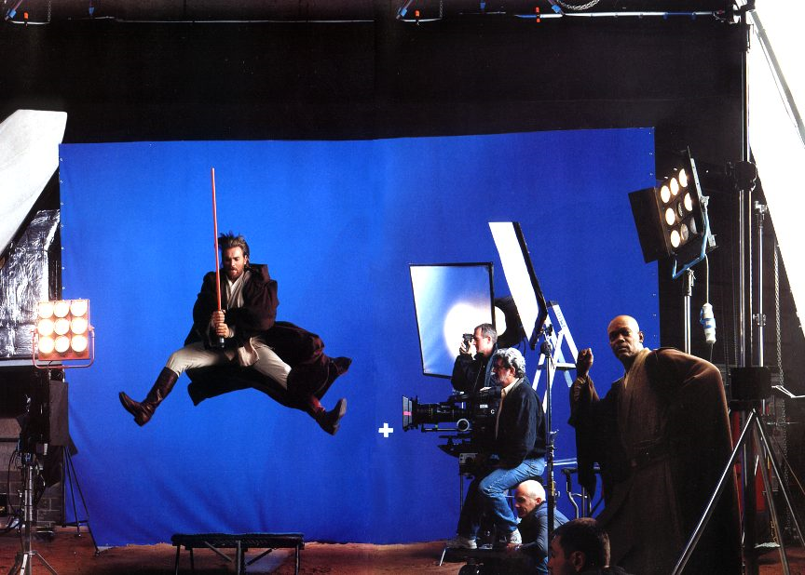
Artistic Effects
Artistic effects are used to make images more visually appealing, to add special effects and to make composite images
Notes:
19

Slide 20
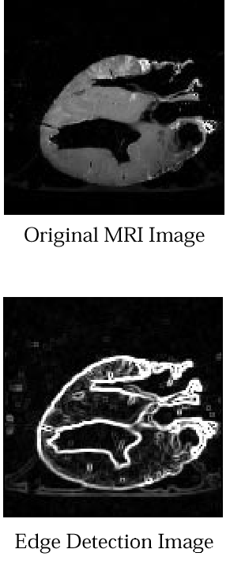
Medicine
Take slice from MRI scan of canine heart, and find boundaries between types of tissue
Image with gray levels representing tissue density
Use a suitable filter to highlight edges
Original MRI Image of a Dog Heart
Edge Detection Image
Notes:
20

Slide 21

Human Life Saviour’s
Subtype of MGMT Prediction Using MRI’ this project uses MRI scans and genetics to predict the subtype of a gene called MGMT, which is associated with the response to cancer treatment. By analyzing both the MRI and the patient's genetic information, doctors can determine the subtype of the MGMT gene and create more personalized treatment plans.

Slide 22
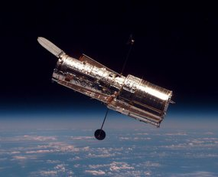
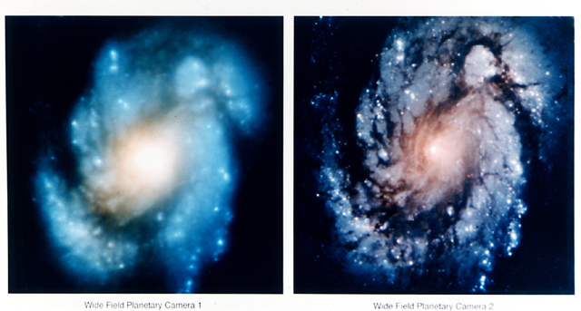
The Hubble Telescope
Launched in 1990 the Hubble telescope can take images of very distant objects
However, an incorrect mirror made many of Hubble’s images useless
Image processing techniques were used to fix this
Notes:
21

Slide 23
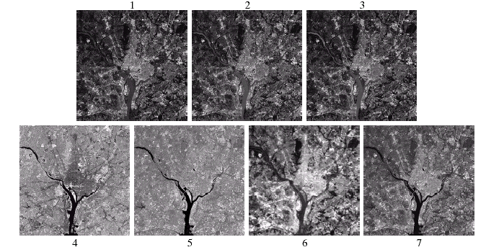
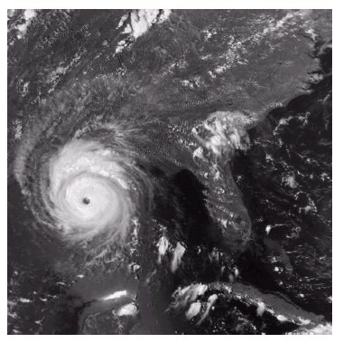
Geographic Information Systems (GIS)
Geographic Information Systems
Digital image processing techniques are used extensively to manipulate satellite imagery
Terrain classification
Meteorology
Infrared imaging
Notes:
22

Slide 24
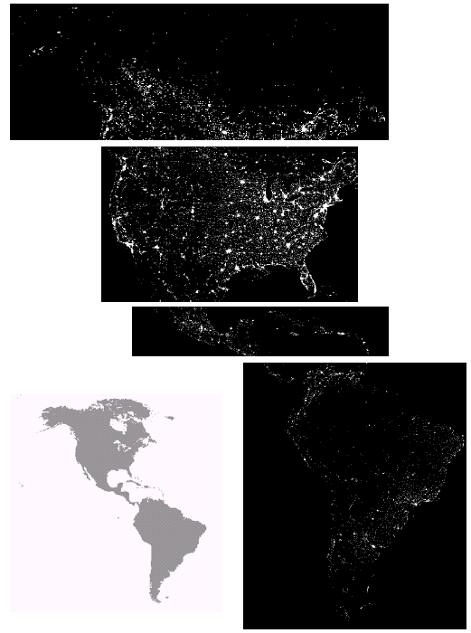
GIS (Cont...)
Night-Time Lights of the World data set
Global inventory of human settlement
Not hard to imagine the kind of analysis that might be done using this data
Visible + Infrared imaging
Notes:
23

Slide 25
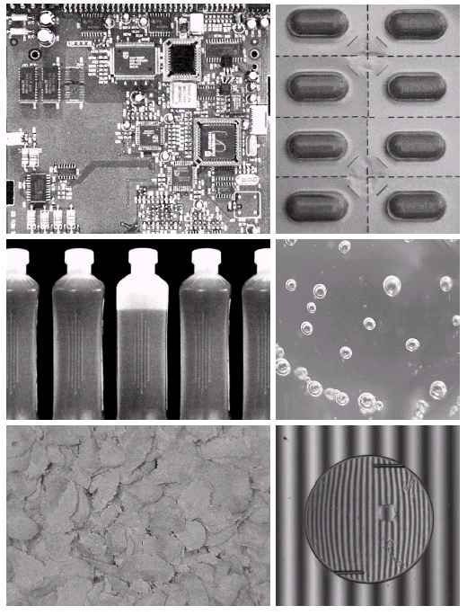
Industrial Inspection
Human operators are expensive, slow and unreliable
Make machines do the job instead
Industrial vision systems are used in all kinds of industries
Can we trust them?
X-Ray imaging
Notes:
24

Slide 26
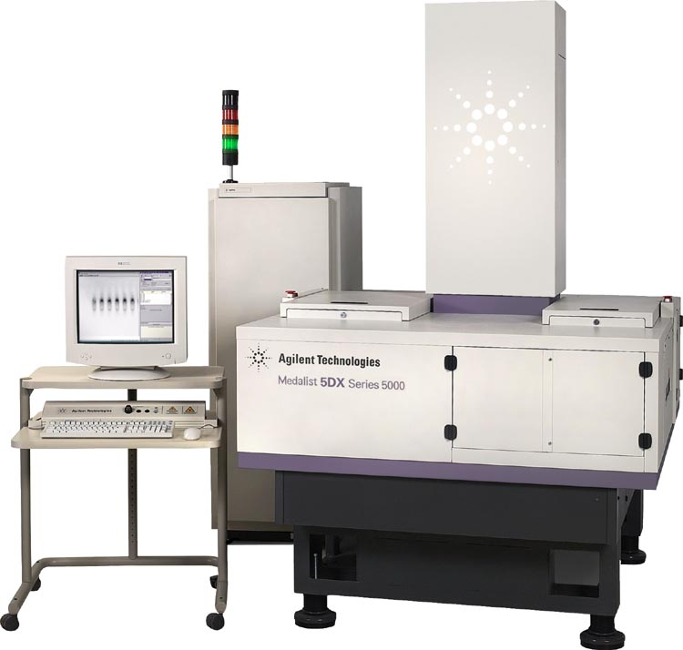
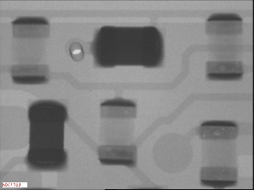
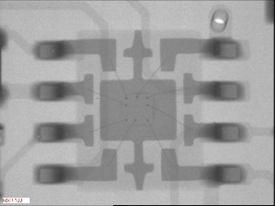
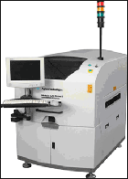
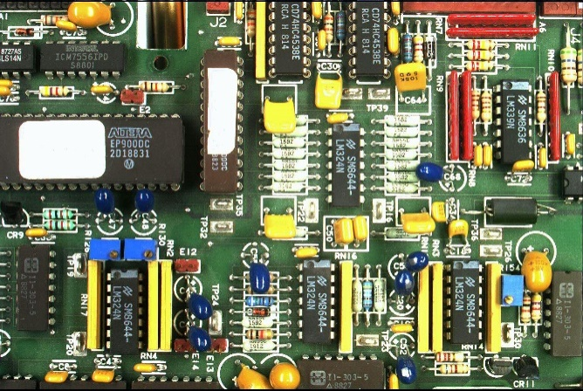
Printed Circuit Board (PCB) inspection
Machine inspection is used to determine that all components are present and that all solder joints are acceptable
Both conventional imaging and x-ray imaging are used
PCB Inspection
Notes:
25

Slide 27
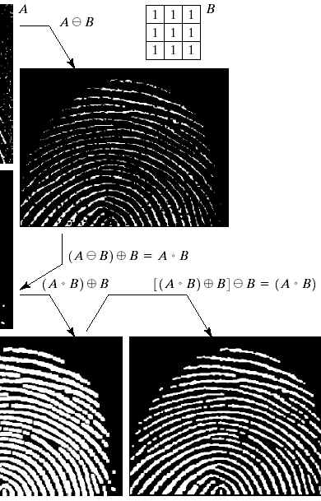
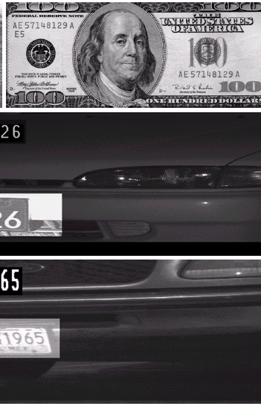
Law Enforcement
Image processing techniques are used extensively by law enforcers
Number plate recognition for speed cameras/automated toll systems
Fingerprint recognition
Enhancement of CCTV images
Notes:
26

Slide 28
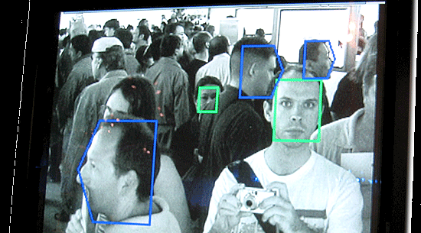
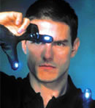
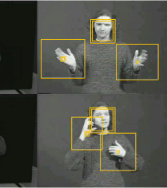
HCI
Try to make human computer interfaces more natural
Face recognition
Gesture recognition
One application is the smart stay?
These tasks can be extremely difficult
Notes:
27

Slide 29
Key Stages in Digital Image Processing
Image Restoration
Morphological Processing
Image Enhancement
Segmentation
Image Acquisition
Object Recognition
Representation & Description
Problem Domain
Colour Image Processing
Image Compression
Notes:
28

Slide 30
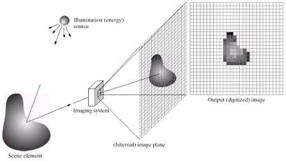
Key Stages: Image Aquisition
Image Restoration
Morphological Processing
Image Enhancement
Segmentation
Image Acquisition
Object Recognition
Representation & Description
Problem Domain
Colour Image Processing
Image Compression
Notes:
29

Slide 31
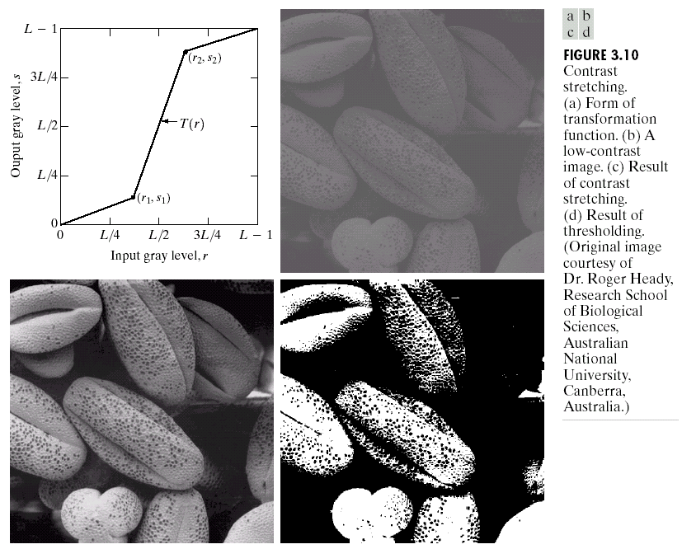
Key Stages: Image Enhancement
Image Restoration
Morphological Processing
Image Enhancement
Segmentation
Image Acquisition
Object Recognition
Representation & Description
Problem Domain
Colour Image Processing
Image Compression
Notes:
30

Slide 32
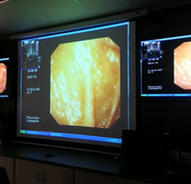
Image Enhancement: Endoscopic Reflection
Endoscopic Reflection Removal
This Photo by Unknown author is licensed under CC BY-ND.

Slide 33
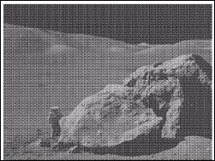
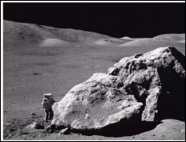
Key Stages: Image Restoration
Image Restoration
Morphological Processing
Image Enhancement
Segmentation
Image Acquisition
Object Recognition
Representation & Description
Problem Domain
Colour Image Processing
Image Compression
Notes:
31
Image restoration is an area that also deals with improving the appearance of an image. However, unlike enhancement, which is subjective, image restoration is objective, in the sense that restoration techniques tend to be based on mathematical or probabilistic models of image degradation.
Image + Degradation function. E.g., defocus degradation, motion degradation

Slide 34
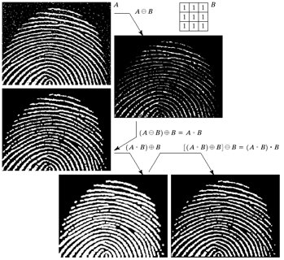
Key Stages: Morphological Processing
Image Restoration
Morphological Processing
Image Enhancement
Segmentation
Image Acquisition
Object Recognition
Representation & Description
Problem Domain
Colour Image Processing
Image Compression
Notes:
32

Slide 35
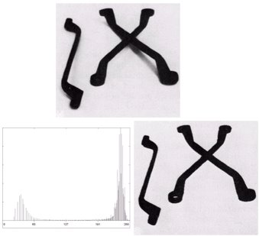
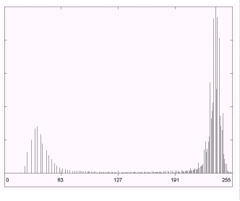
Key Stages: Segmentation
Image Restoration
Morphological Processing
Image Enhancement
Segmentation
Image Acquisition
Object Recognition
Representation & Description
Problem Domain
Colour Image Processing
Image Compression
Notes:
33

Slide 36
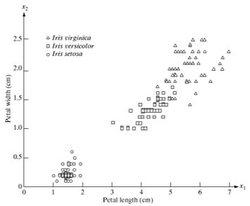
Key Stages: Object Recognition
Image Restoration
Morphological Processing
Image Enhancement
Segmentation
Image Acquisition
Object Recognition
Representation & Description
Problem Domain
Colour Image Processing
Image Compression
Notes:
34

Slide 37
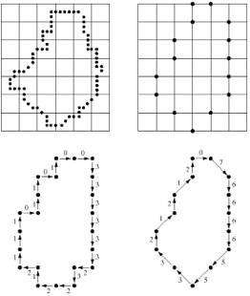
Key Stages: Representation and Description
Image Restoration
Morphological Processing
Image Enhancement
Segmentation
Image Acquisition
Object Recognition
Representation & Description
Problem Domain
Colour Image Processing
Image Compression
Notes:
35

Slide 38
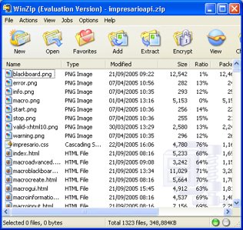
Key Stages: Image Compression
Image Restoration
Morphological Processing
Image Enhancement
Segmentation
Image Acquisition
Object Recognition
Representation & Description
Problem Domain
Optional
Colour Image Processing
Image Compression
Notes:
36

Slide 39
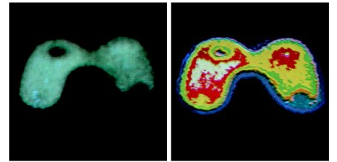
Key Stages: Color Image Processing
Image Restoration
Morphological Processing
Image Enhancement
Segmentation
Image Acquisition
Object Recognition
Representation & Description
Problem Domain
Optional
Colour Image Processing
Image Compression
Notes:
37

